Slide 1
Marketing campaigns analysis
Supervised by:
Dr.Yasser Al-Habibi
Eng. Mariam Farid
Eng. Aya Taha

Slide 2
Team Members
Sara Rafe’a Mohamed 89525
Mariam Ashraf Abdelgawad 89656
Shehab El deen Hussein 89480
Mostafa Ahmed Abdelmawgood 89391

Slide 3

agenda
k
02
03
04
05
01
Recap on previous
Problem definition
What are we doing!
Collecting phase
Analyzing phase
06
07
08
09
10
encoding
Plotting & scaling
dashboard
System architecture
Algorithms and methodologies
11
12
13
14
Software tools
Expected outcomes
conclusion
reference

Slide 4
Recap on previous work
Introduction:
Marketing campaigns promote products or business through different types of media, such as television, radio, print, and online platforms.
And thinking analytically to scale marketing performance has always been a sought-after skill. Knowing how to perform a campaign analysis is key, as this will ensure that your marketing activities are relevant and timely to achieving your organizational objectives.

Slide 5
Problem definition
Marketing campaigns is still a bunch of numbers and statistics , therefore some times results of the campaign does not correspond to the expected outcomes and sometimes it fails . so it needs to be measured and it needs a context to make sense and to see the reasons behind this so we can learn and avoid the old mistakes , that’s why they use key performance indicators and common marketing metrics .

Slide 6
What are we analyzing specifically?
We are working on “Bank” campaign’s analysis we’ve extracted a specific CSV file for all the outcomes generated by the campaign

Slide 7
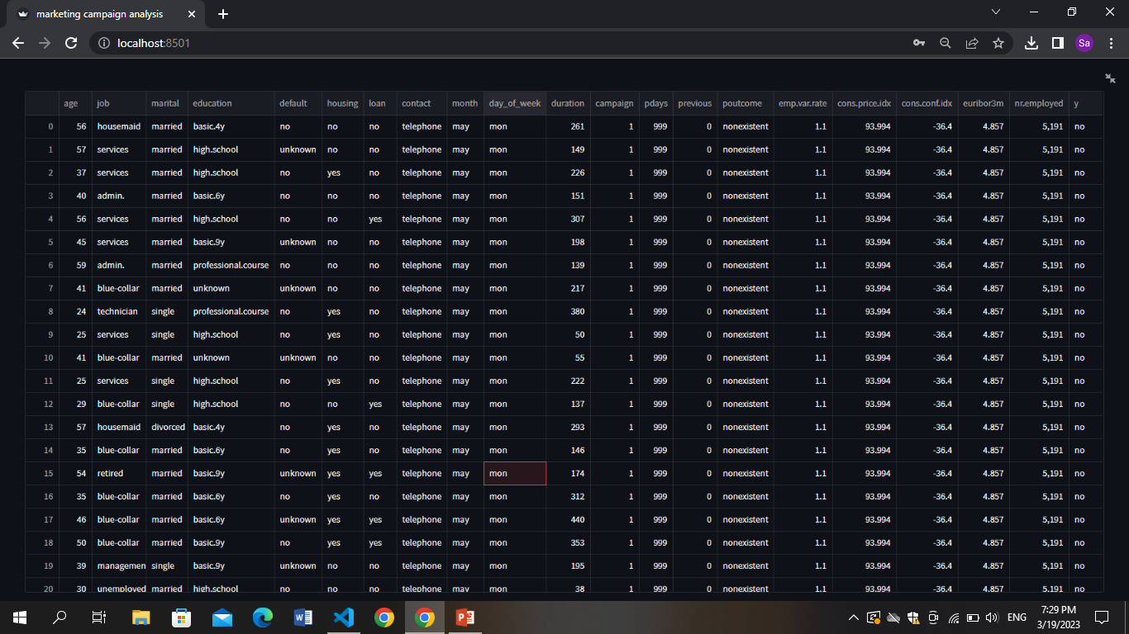
Collecting our dataset
Our dataset consist of 41188 rows x 21 columns
It was very difficult to analyze manually so here comes the power of AI

Slide 8
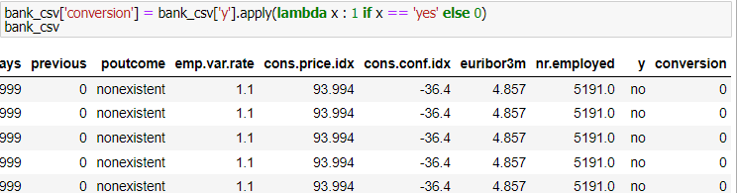
Analyzing the data
We started with reading the data
Then we started to reshape the conversion attribute to zeros and ones
1 ---> converted & 0 ---->not converted

Slide 9
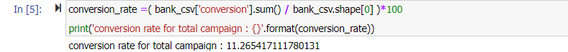
Analyzing the data
We found out that our data set contains no null values
So we started to calculate the KPIs for this data set using the following lines:
our KPI here was the conversion rate

Slide 10
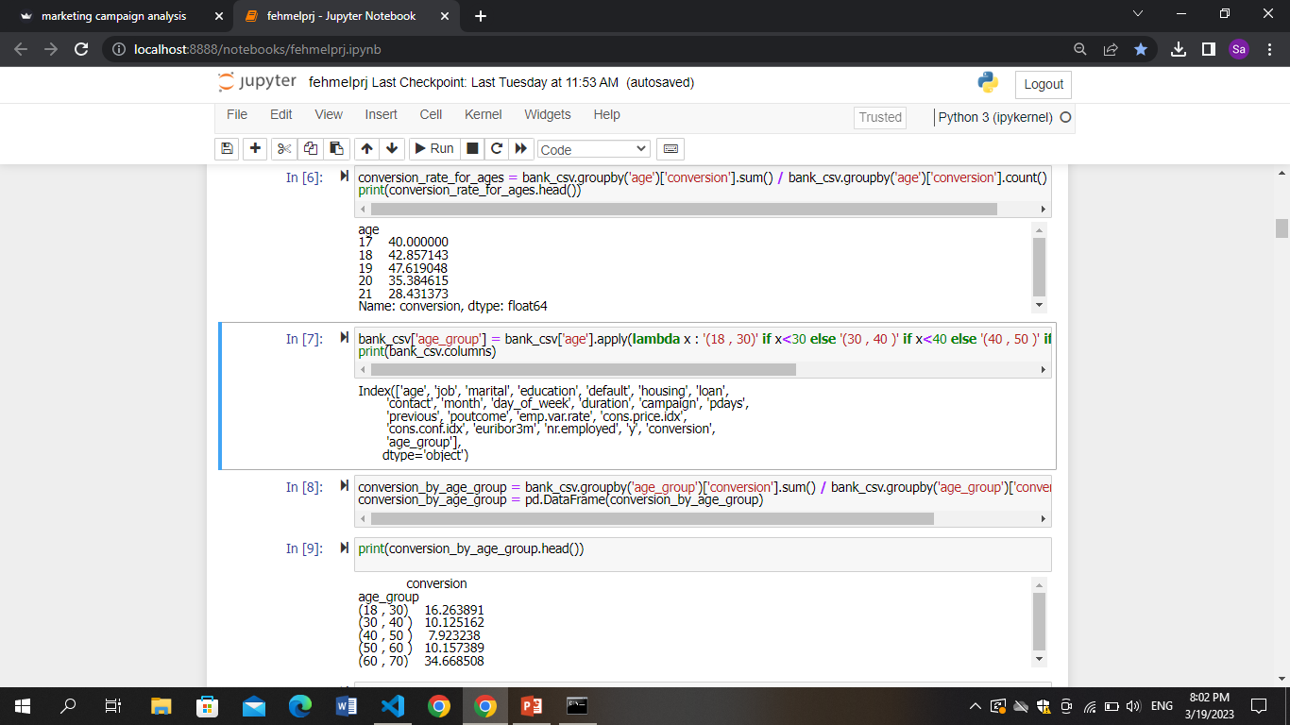
Analyzing the data
We then grouped the ages into 3 different groups using the following lines

Slide 11
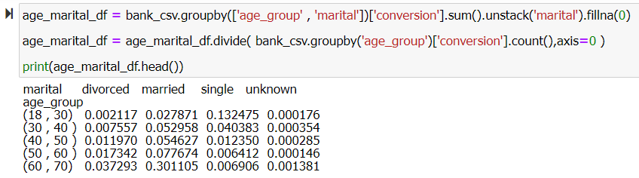
Analyzing the data
We grouped the customer’s marital status into 4 groups and defined percentage of each statue according to the age

Slide 12
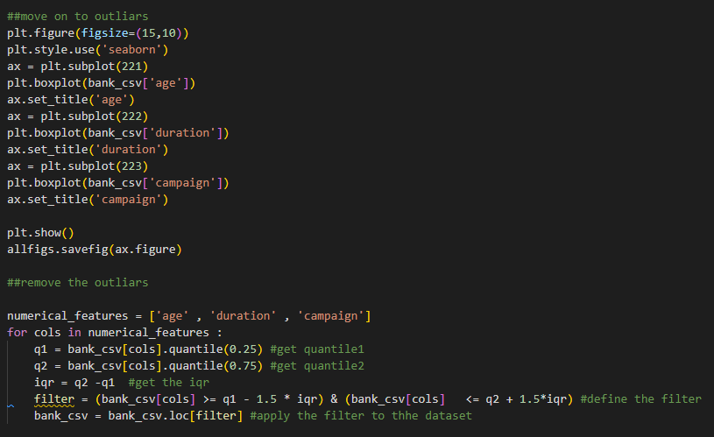
Analyzing the data
We moved on to outliers
Then removed the outliers in order to proceed for more feature engineering techniques
Viewed the data after removing outlier

Slide 13
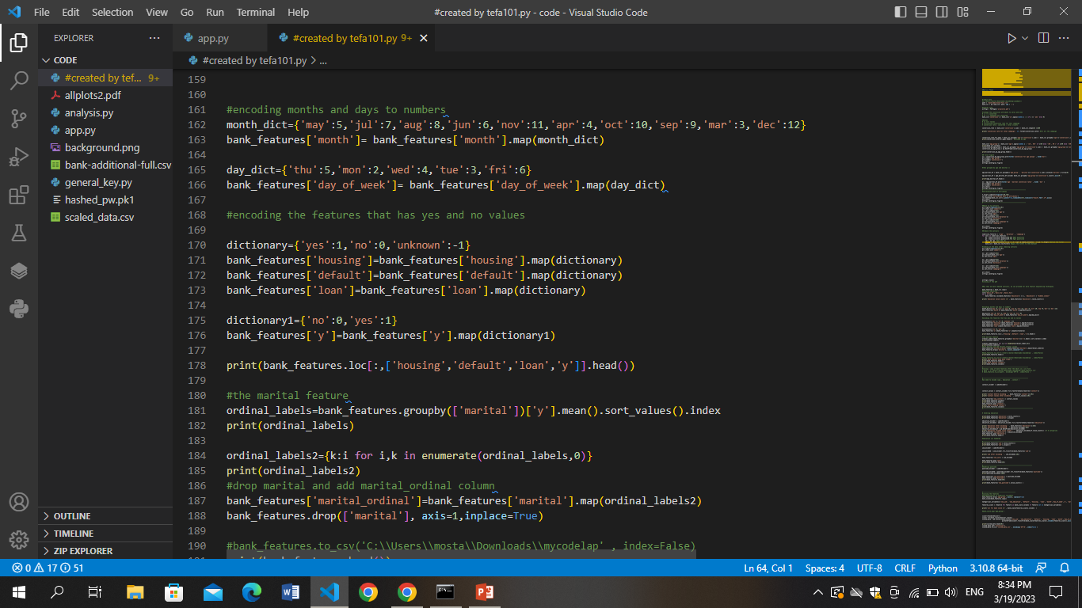
Encoding phase
Then we encoded each entry through the following codes:

Slide 14
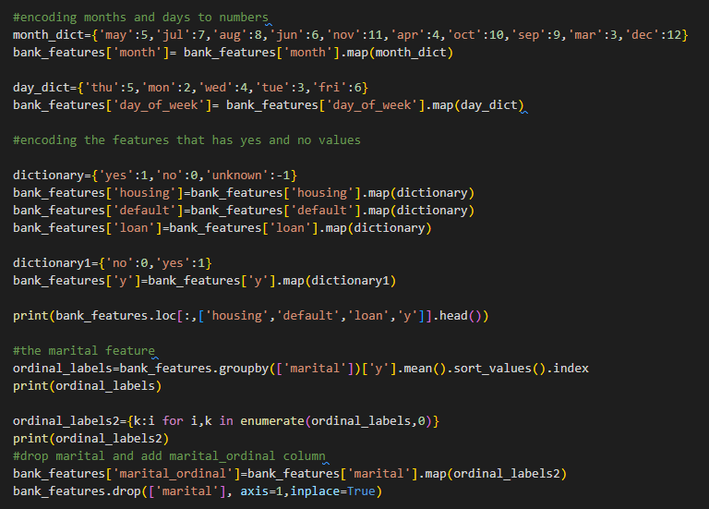
Encoding phase
The main reason for encoding our data is that we need to convert all entries to numerical values

Slide 15
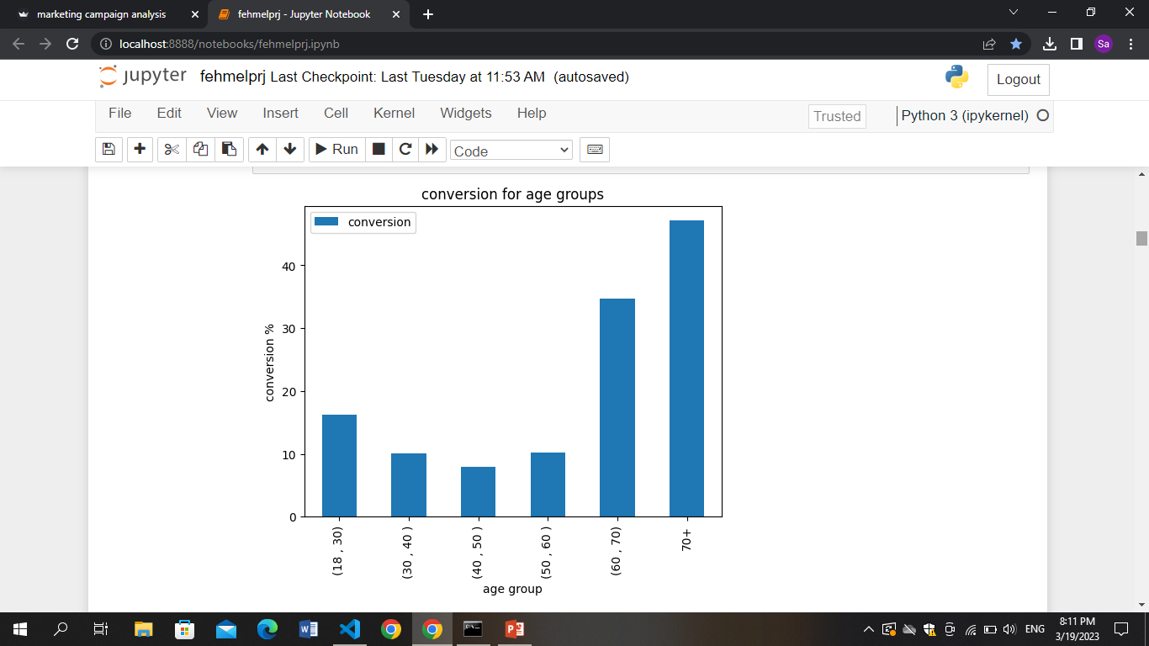
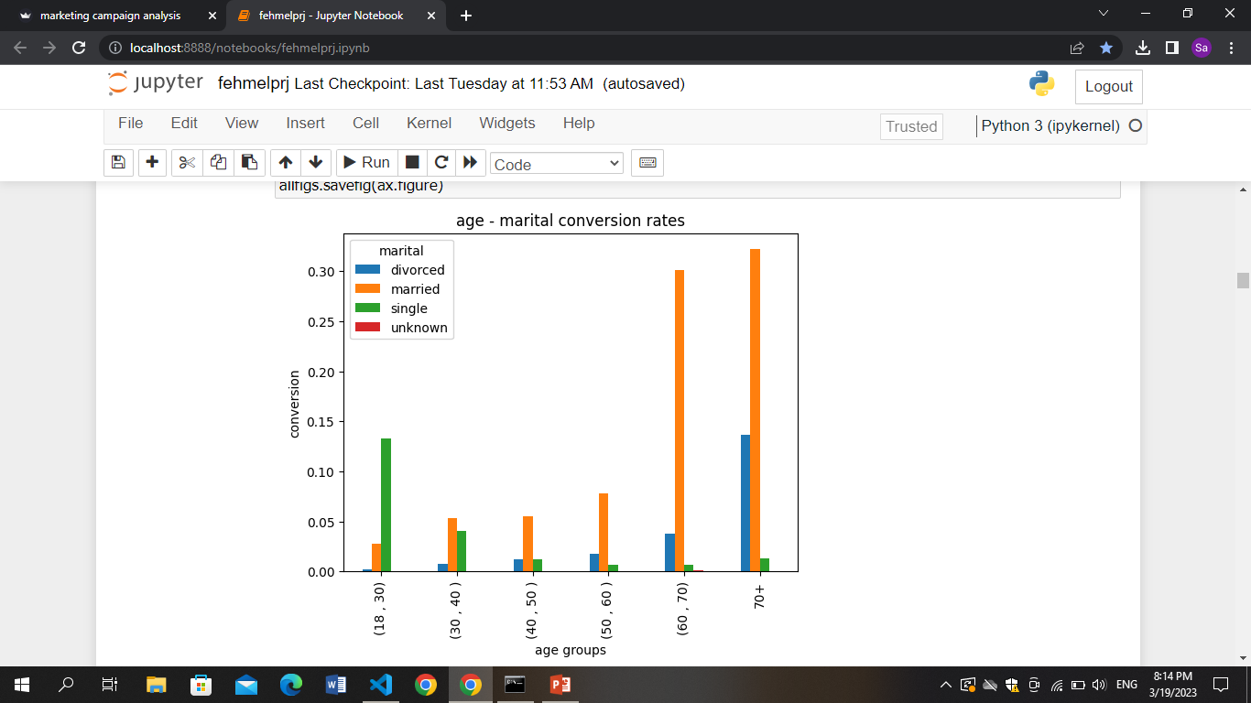
Plotting phase
Then we plotted our figures representing our data:

Slide 16
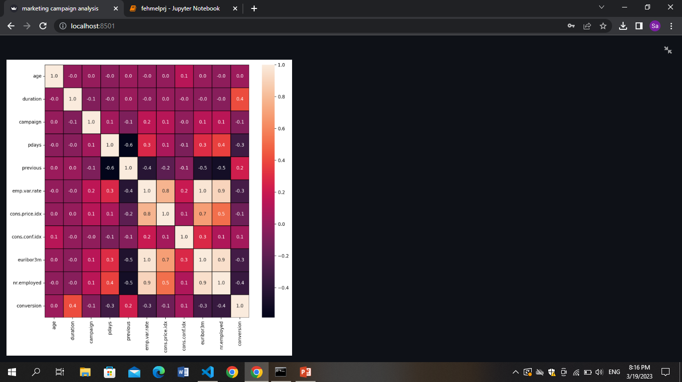
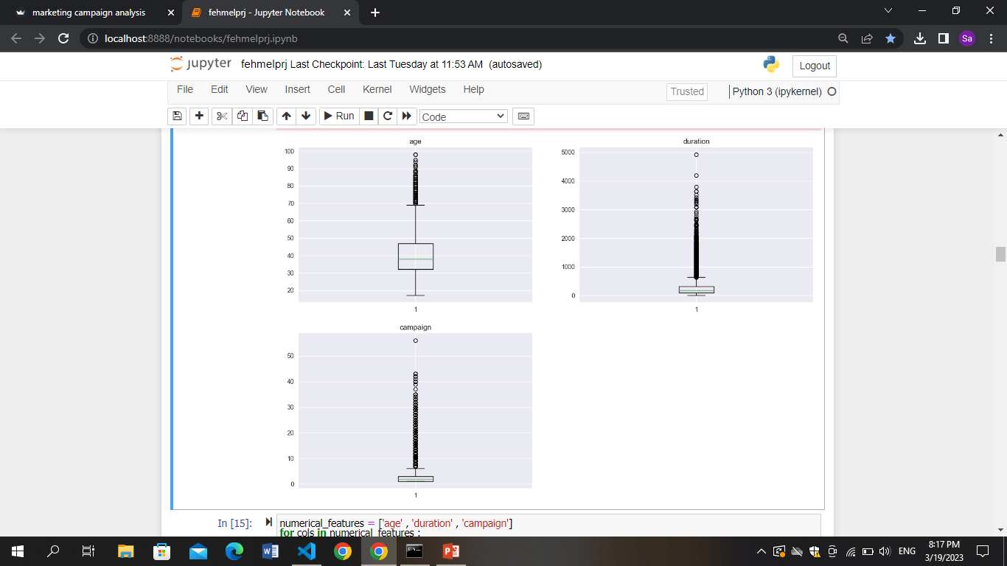
Plotting phase

Slide 17
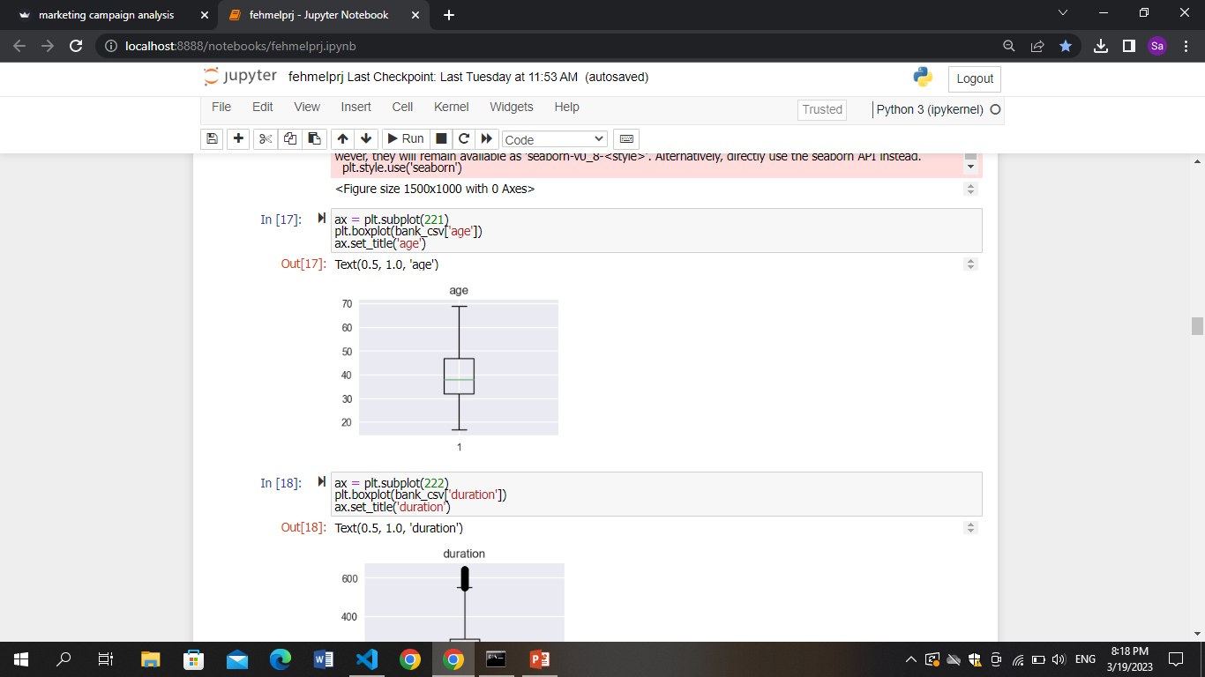
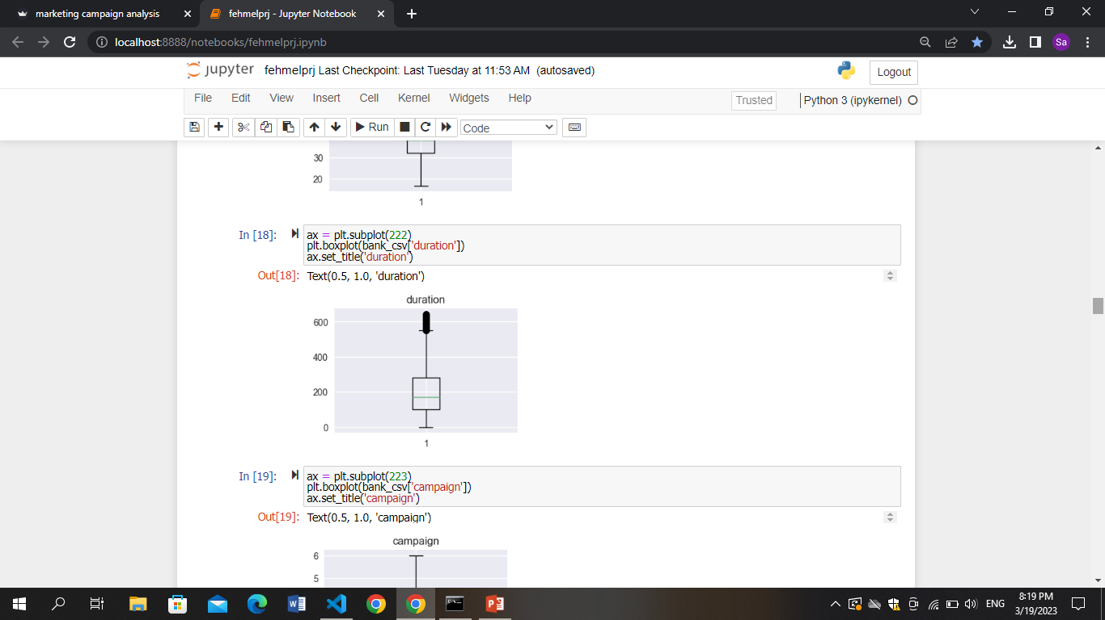
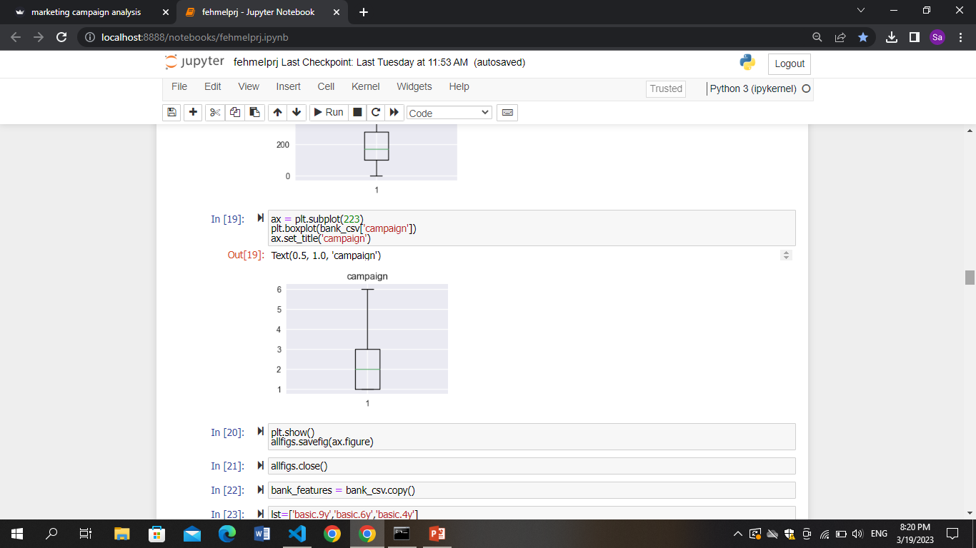
Plotting phase
Then we saved all of these figures in a pdf using python library

Slide 18
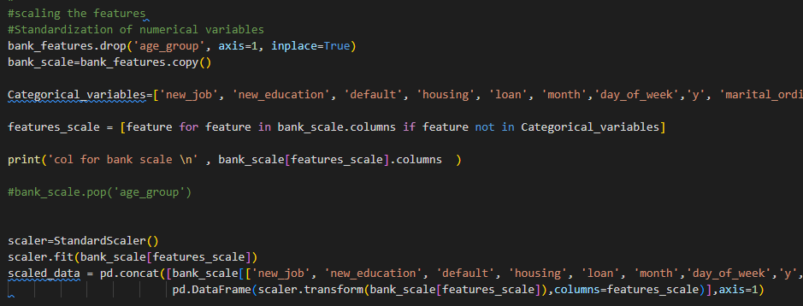
Scaling features phase
Through this code we were able to create a new file containing standardized and scaled dataset

Slide 19
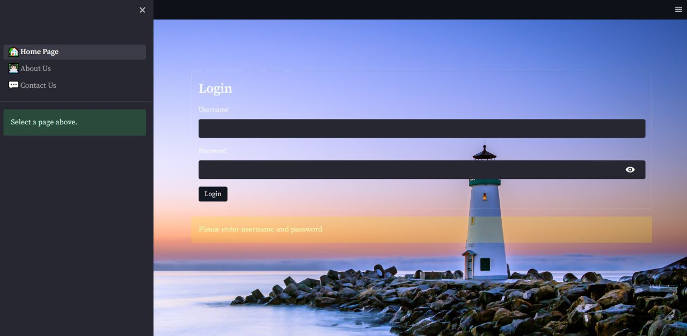
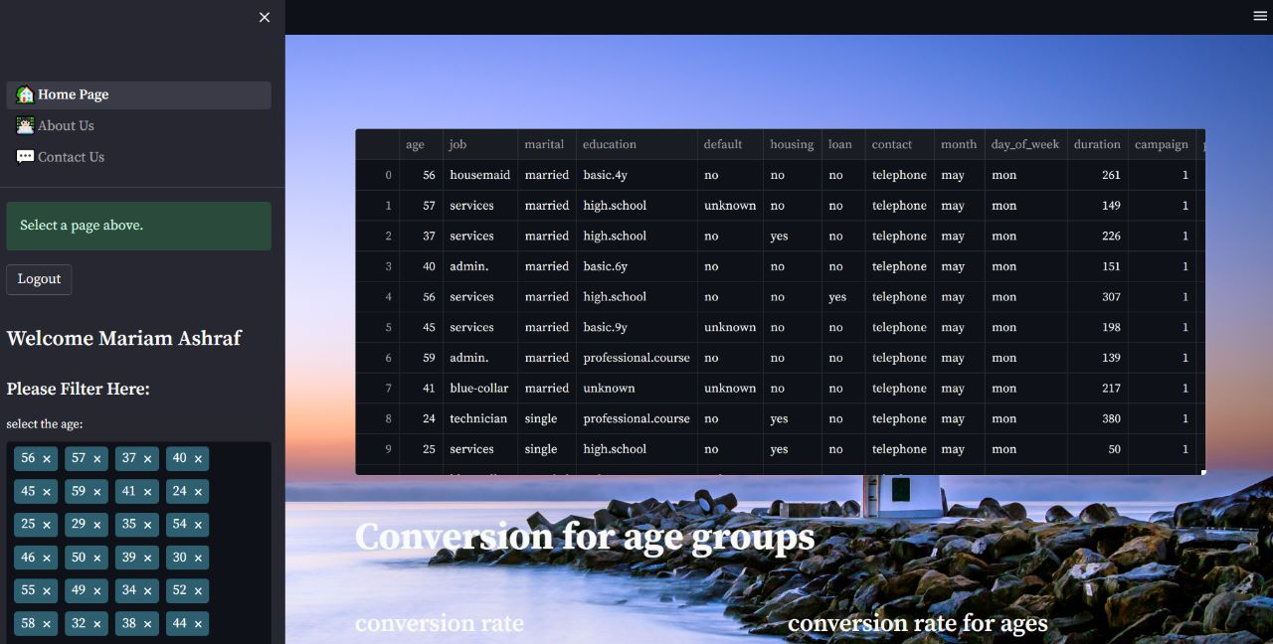
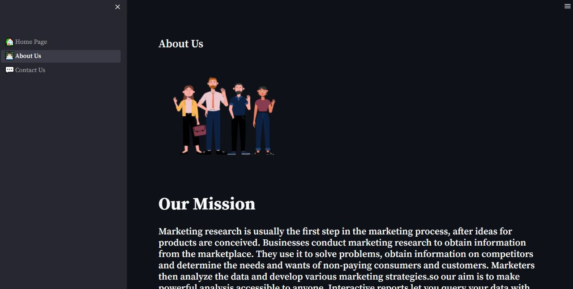
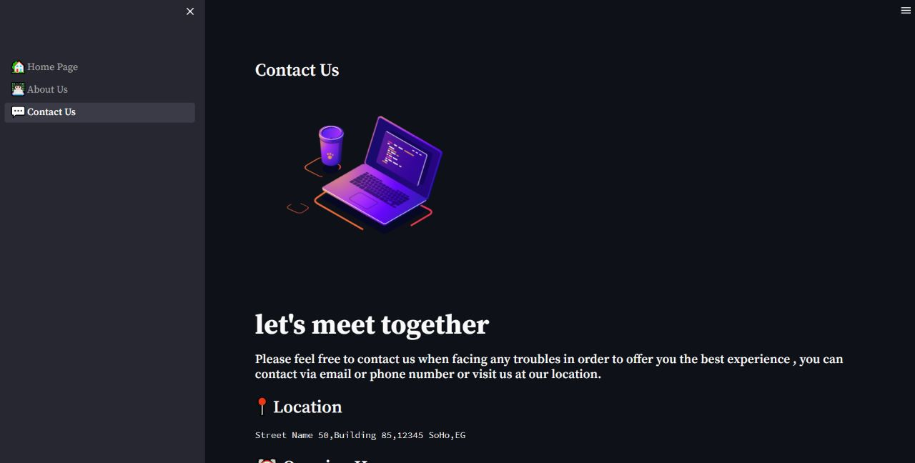
Designing dashboard phase
Screenshots to our dashboard:

Slide 20
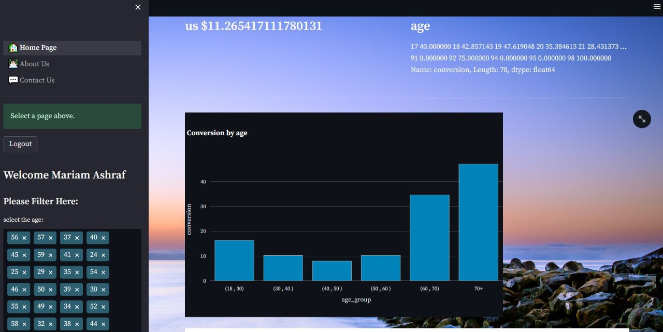
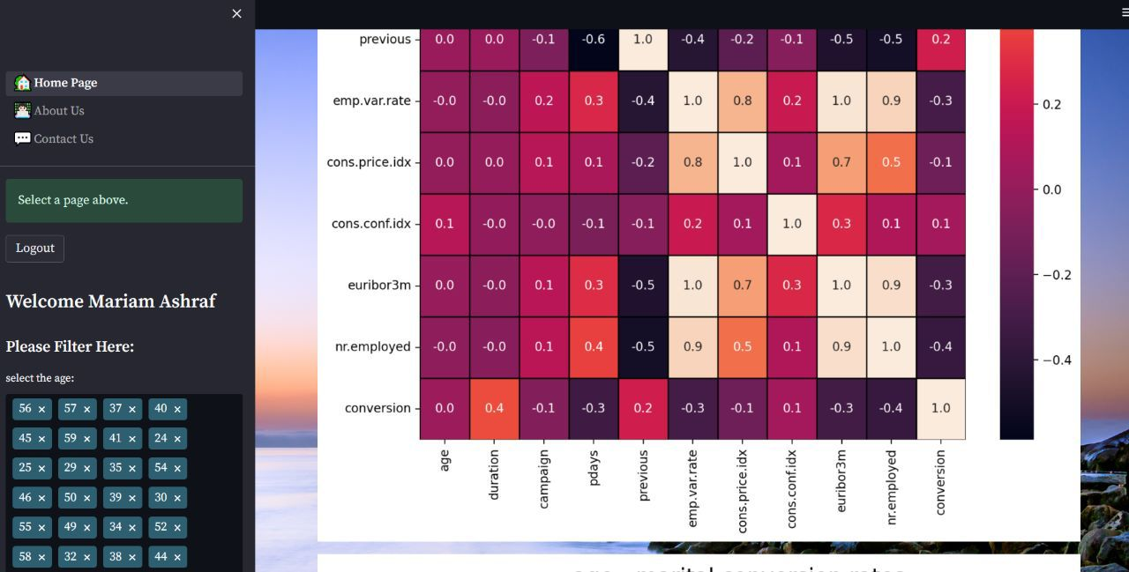
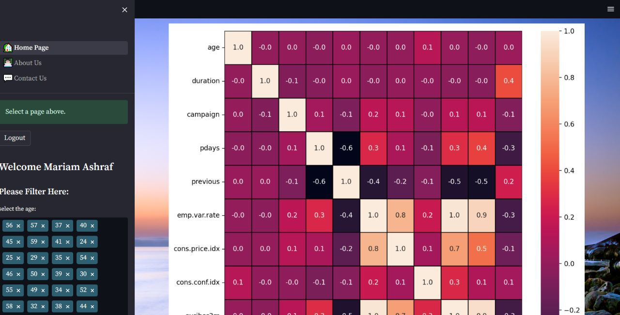
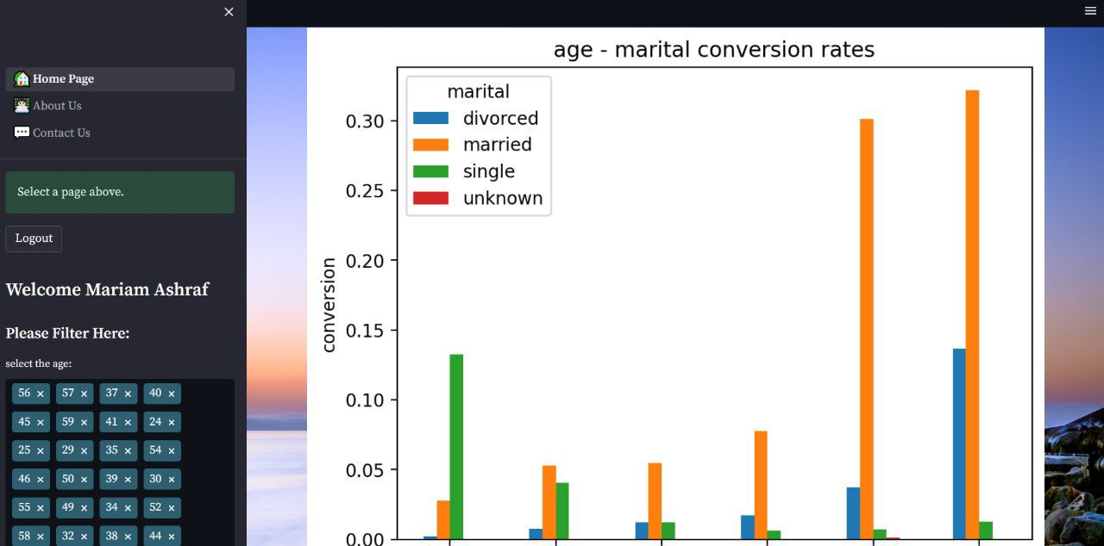
Designing dashboard phase
Screenshots to our dashboard:

Slide 21
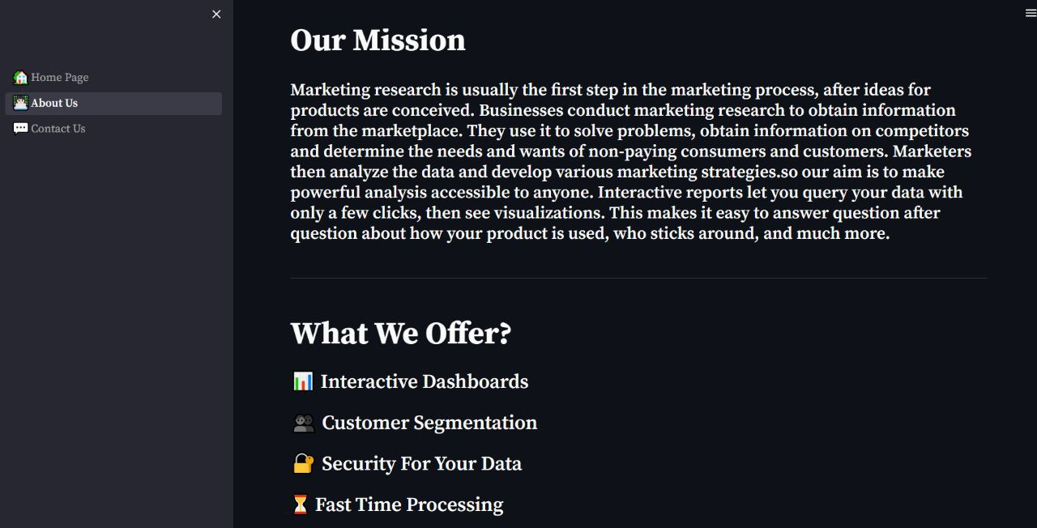
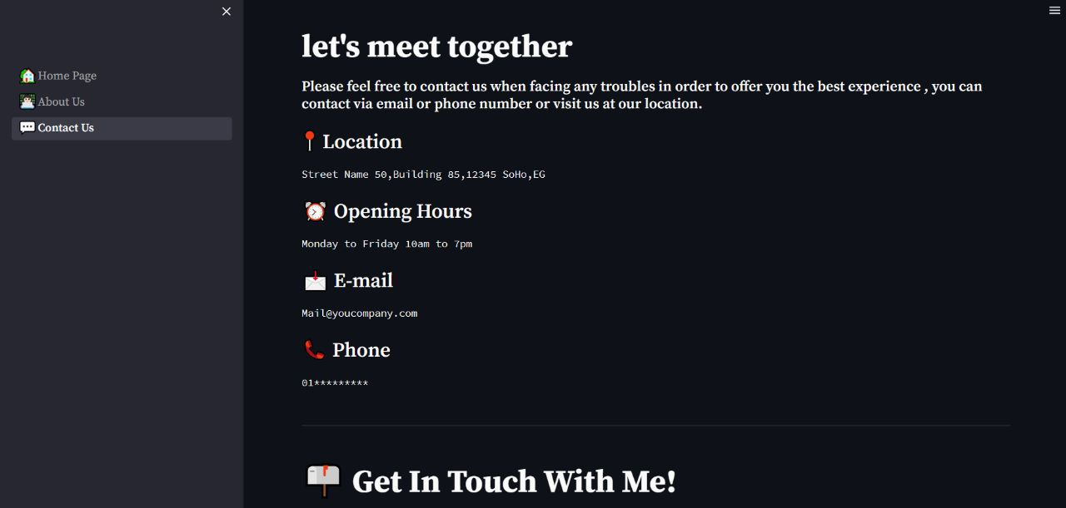
Designing dashboard phase
Screenshots to our dashboard:

Slide 22
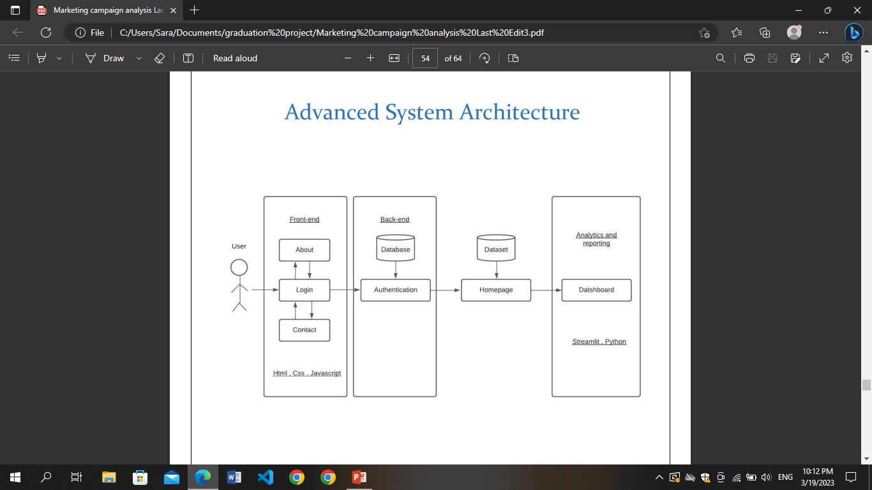
System architecture
Streamlit,css

Slide 23
Implemented algorithms methodologies and techniques
We start by the descriptive analysis process in which we conduct the following steps:
• Drawing out objectives
• Collecting data
• Cleaning data
Applying different analysis techniques To define the KPI’s of our project which are
• Cost per acquisition
• Sales revenue
• Digital marketing KPI’s
• Return on investment

Slide 24
Implemented algorithms methodologies and techniques
Then we perform the explanatory analysis:
• Elicit the research hypothesis
1. Select the response (explained) variable Y
2. Select the main explanatory variable X
• Identify the covariates
• Check that the conditions are met
• Check the robustness of the model
And then the final step which is predictive analysis to build a machine learning model
• Cumulative distribution function
• Probability mass function
• Linear correlation
• K-mean
• Linear and logistic regression

Slide 25
Software tools
The project involved using various tools to collect, analyze and visualize data
Jupyter notebook
Streamlit (packages: streamlit-authenticator)
Css
Python (packages: Pandas, Matplotlib, Sklearn, Numpy..etc)

Slide 26

Expected outcomes
Create a Data Visualization Platform (Web Application)
Provide interactive dashboards
Prepare Accurate Statistical Reports (PDF)

Slide 27

CONCLUSION
Marketing research is usually the first step in the marketing process, data are used to obtain information in order to solve problems and develop better marketing strategies.
data-driven decisions can be obtained via statistical reports and interactive dashboards made by data analytics team in the marketing department. highlighting the events or metrics that matter and exporting impactful images during the campaign or whenever needed, all of this made the field more competitive than before.

Slide 28
REFERENCES
“https://waypointmc.com/blog/analyzing-marketingresults#:~:text=What%20is%20Marketing%20Analysis%3F,improve%20future%20conv ersions%20or%20sales.”
“Market analysis: accessing your business opportunities” by William Winston, Robert E Stevens, Philip K Sherwoa, John Paul Dunn. copyright year 1993.
https://www.agorapulse.com/blog/marketing-analytics-case-studies/
https://pulse.microsoft.com/en/transform-en/na/fa1-how-microsoft-became-anintelligence-driven-organization-and-how-your-business-could-do-the-same/
https://www.researchgate.net/publication/364616957_Marketing_Analytics_Case_Study_ Hotel_Catalonia_Barcelona_Plaza

